Slide 1
Basic Concepts
Computer Organization and Assembly Language
Lec#1
Computer Science Department
National University of Computer and Emerging Sciences Islamabad

Slide 2
Overview
Welcome to COAL 2020
Course Contents
Assembly-, Machine-, and High-Level Languages
Assembly Language Programming Tools
Programmer’s View of a Computer System
Data Representation

Slide 3
Welcome to COAL 2020
Instructor:
Ameen Chilwan
  Office#:C-202F
  Email: ameen.chilwan@nu.edu.pk

Slide 4
Welcome to COAL 2020
Office Hours: Not yet decided
  Folder on Slate: Computer Organization & Assembly Language
  Google Classroom Code: yabytul

Slide 5
Class Particulars
Credit Hours:
  4.0 [3+1]
Course Structure:
  Three Lectures a week (Each of duration 1 hour).
  One lab of 3-hr in each week

Slide 6
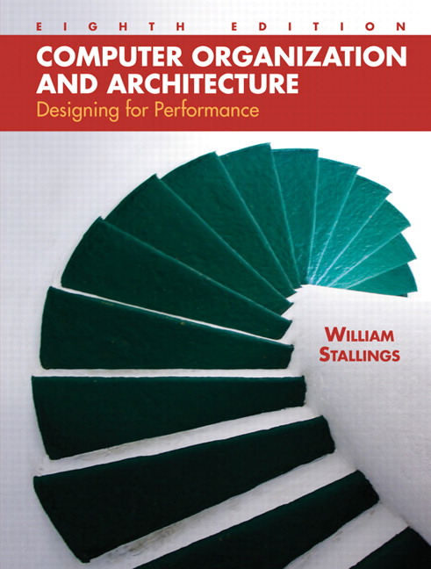
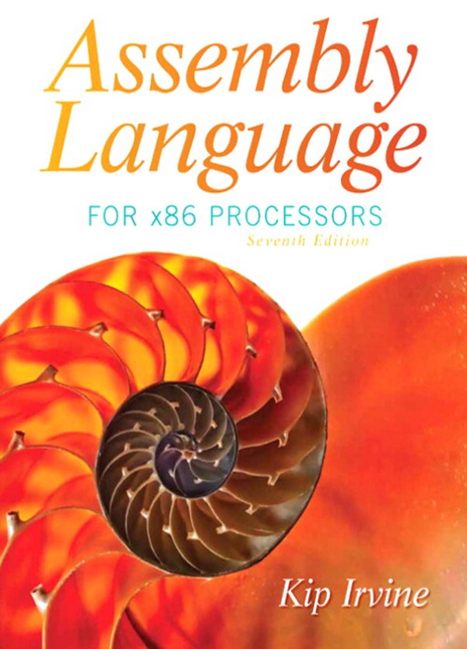
Text Books
  Computer Organization and Architecture, William Stallings,
    10th edition
Kip Irvine: Assembly Language for Intel-Based Computers
  7th edition
Read the textbook!
  Key for learning and obtaining a good grade

Slide 7
Tentative Grading Policy
Class
Assignments | 15%
Quizzes | 10%
Midterm Exam | 25%
Final Exam | 40%
Project | 10%
Lab
Lab Evaluation [Lab tasks + Lab assignment + Lab Exams] + Project | 60% [10+10+40] +40%

Slide 8
Grading Policy
There is simply no chance of extension in any of the deadline, what so ever
You can request for re-checking of any of your evaluation as per following rules;
Exams: Same day
Assignments: 2 days after handing-over
Quizzes: 2 days after handing over
Warning! After due time, request will not be considered even if it’s genuine.
Warning! Keep checking your flex regularly and don’t come in the end with bulk of queries in hand which you never presented earlier and now you are on the Edge.

Slide 9
General Guidelines
Visit SLATE course folder regularly for updates
No email submissions when SLATE is there.
Cheating cases are intolerable. You will be given negative marks for cheated stuff irrespective of the fact that you were provider or the other one. Your cheating in exam will make it easy for you to step down from the Course with an ‘F’ grade. . . ☹
  There will be no re-take of any evaluation except for exams for which you should follow proper procedure
Quiz is inevitable so always, expect One ☺

Slide 10
General Guidelines
You have to depend on yourself to have a good grade in the course
  You need to appear in demo to have it graded otherwise you will be given 5% of the total marks even if it was best assignment/project of the class
  Grading will be individual even for group tasks. So better to shine with your own work in hand otherwise don’t complaint
  There will always be a quiz of written assignments whose performance will be considered as performance in that assignment.

Slide 11
Next …
Welcome to COAL 2020
Course Contents
Assembly-, Machine-, and High-Level Languages
Assembly Language Programming Tools
Programmer’s View of a Computer System
Data Representation

Slide 12
Course Contents- Organization
Introduction to Computer Organization and Assembly Language
Instruction Set Architecture
Computer Evolution and Performance
Computer Components
A Top Level View of Computer Function
Interconnection Structure
Computer Memory System

Slide 13
Course Contents- Organization
Performance of a Computer System
Introduction to Microcontroller
Microcontroller Vs Microprocessor
Arduino Microcontroller
Data Transfer and Addressing Modes
Input Output Techniques
Computer Arithmetic
High Level Interfacing

Slide 14
Course Contents- Assembly Language
Basic Elements of Assembly Language
Flat Memory Program Template
Data-Related Operators & Directives
Array Processing
String Processing
Stack Operations and Procedures

Slide 15
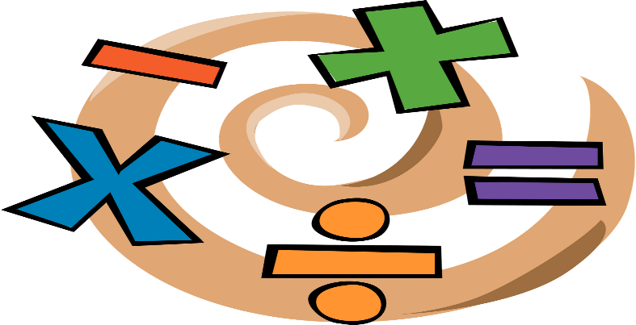
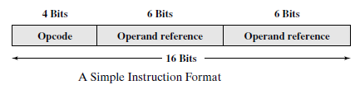
Computer Architecture
Architecture is those attributes visible to the programmer
  Instruction set, number of bits used for data representation, I/O mechanisms, addressing techniques.
  e.g. Is there a multiply instruction?

Slide 16
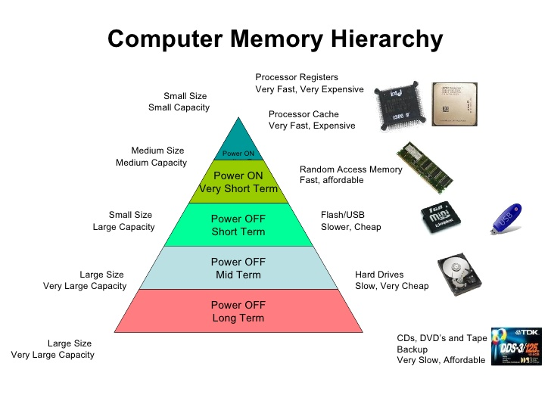
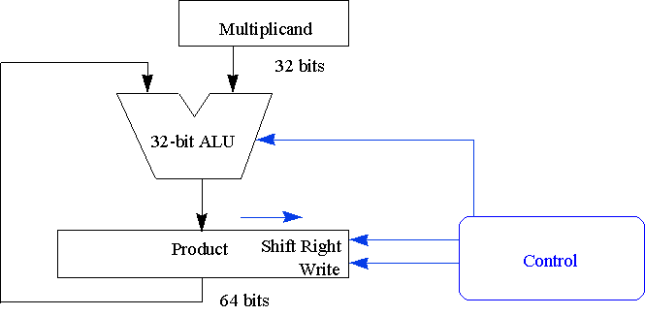
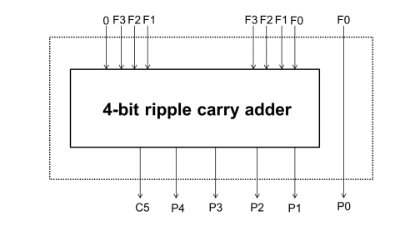
Computer Organization
Organization is how features are implemented
  Control signals, interfaces, memory technology.
  e.g. Is there a hardware multiply unit or is it done by repeated addition?

Slide 17
Next …
Welcome to COAL 2020
Course Contents
Assembly-, Machine-, and High-Level Languages
Assembly Language Programming Tools
Programmer’s View of a Computer System
Data Representation

Slide 18
ASSEMBLY LANGUAGE

Slide 19
Some Important Questions to Ask
What is Assembly Language?
Why Learn Assembly Language?
What is Machine Language?
How is Assembly related to Machine Language?
What is an Assembler?
How is Assembly related to High-Level Language?
Is Assembly Language portable?

Slide 20
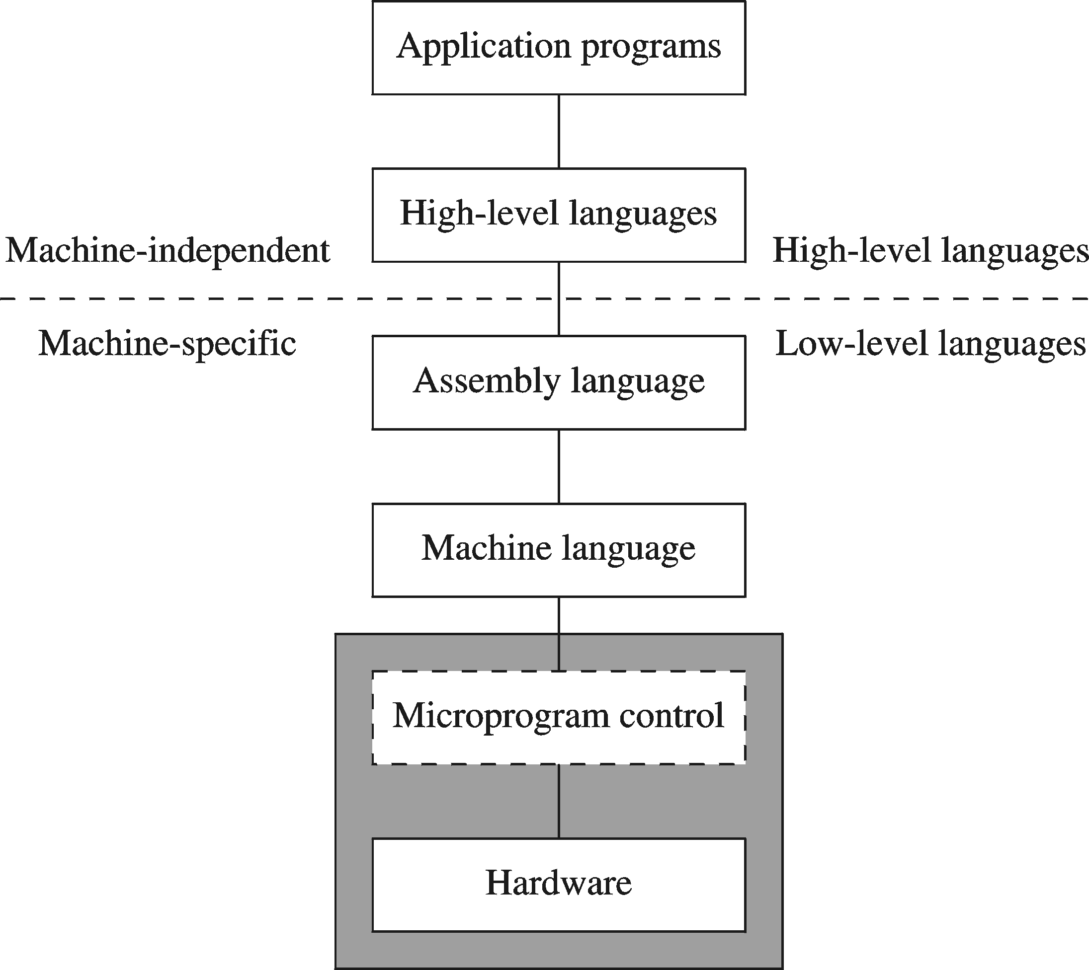
A Hierarchy of Languages

Slide 21
Assembly and Machine Language
Machine language
  Native to a processor: executed directly by hardware
  Instructions consist of binary code: 1s and 0s
Assembly language
  Slightly higher-level language
  Readability of instructions is better than machine language
  One-to-one correspondence with machine language instructions
Assemblers translate assembly to machine code
Compilers translate high-level programs to machine code
  Either directly, or
  Indirectly via an assembler

Slide 22
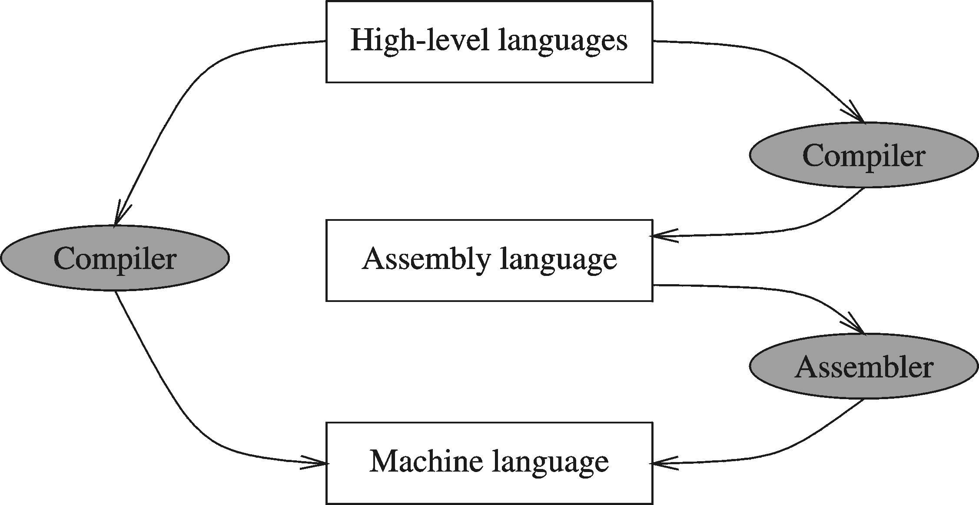
Compiler and Assembler
Notes:
Code verification i.e., hard to see if compiler is working correctly in case of direct translation
Same IS may have different relocateable object files – assembler can find it by itself
An object file is a file containing object code, meaning relocatable format machine code that is usually not directly executable. There are various formats for object files, and the same object code can be packaged in different object files. Anobject file may also work like a shared library.

Slide 23
Translating Languages
English: D is assigned the sum of A times B plus 10.
High-Level Language: D = A * B + 10
A statement in a high-level language is translated typically into several machine-level instructions
Intel Assembly Language:
mov eax, A
mul B
add eax, 10
mov D, eax
Intel Machine Language:
A1 00404000
F7 25 00404004
83 C0 0A
A3 00404008

Slide 24
Advantages of High-Level Languages
Program development is faster
  High-level statements: fewer instructions to code
Program maintenance is easier
  For the same above reasons
Programs are portable
  Contain few machine-dependent details
    Can be used with little or no modifications on different machines
  Compiler translates to the target machine language
  However, Assembly language programs are not portable

Slide 25
Why Learn Assembly Language?
Two main reasons:
  Accessibility to system hardware
  Space and time efficiency
Accessibility to system hardware
  Assembly Language is useful for implementing system software
  Also useful for small embedded system applications
Space and Time efficiency
  Understanding sources of program inefficiency
  Tuning program performance
  Writing compact code

Slide 26
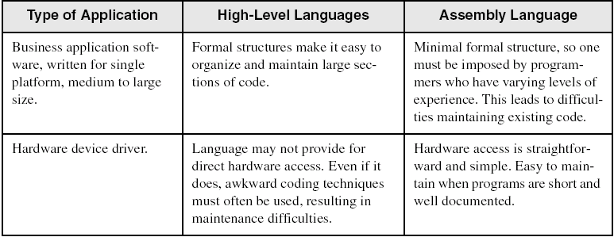
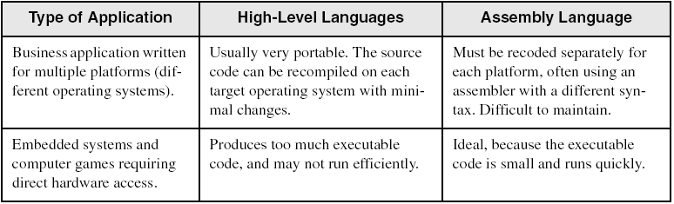
Assembly vs High-Level Languages
Some representative types of applications:

Slide 27
Next …
Welcome to COAL 2020
Course Contents
Assembly-, Machine-, and High-Level Languages
Assembly Language Programming Tools (Lab)
Programmer’s View of a Computer System
Data Representation

Slide 28
Next …
Welcome to COAL 2020
Course Contents
Assembly-, Machine-, and High-Level Languages
Assembly Language Programming Tools
Programmer’s View of a Computer System
Data Representation

Slide 29
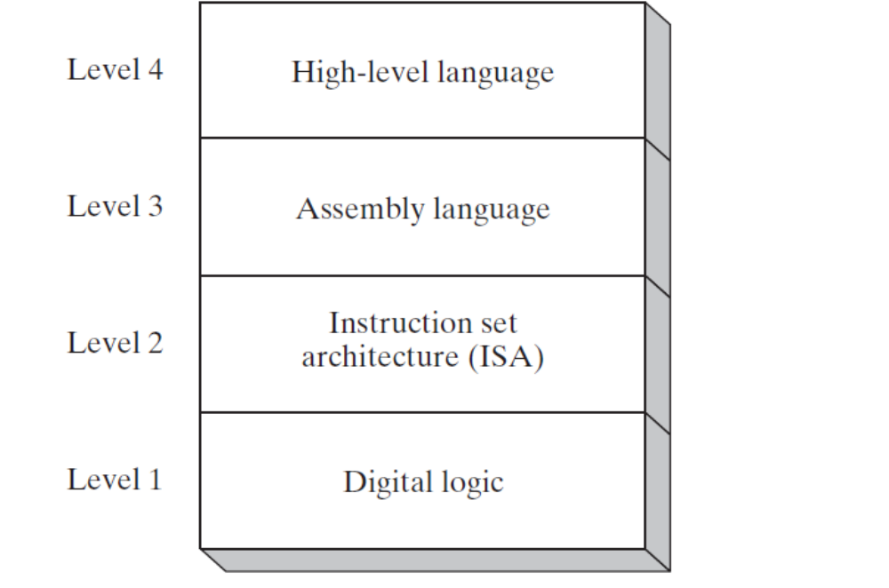
Programmer’s View of a Computer System
Increased level of abstraction
Each level hides the details of the level below it

Slide 30
Programmer's View – 2
Application Programs (Level 4 )
  Written in high-level programming languages
  Such as Java, C++, Pascal, Visual Basic . . .
  Programs compile into assembly language level (Level 4)
Assembly Language (Level 3)
  Instruction mnemonics are used
  Have one-to-one correspondence to machine language
  Calls functions written at the operating system level
  Programs are translated into machine language
Notes:
In computer assembler (or assembly) language, a mnemonic is an abbreviation for an operation. It's entered in the operation code field of each assembler program instruction. For example, on an Intel microprocessor, inc ("increase by one") is a mnemonic.

Slide 31
Programmer's View – 3
Instruction Set Architecture (Level 2)
  Specifies how a processor functions
  Machine instructions, registers, and memory are exposed
  Machine language is executed by Level 1 (microarchitecture)
Digital Logic (Level 1)
  Implements the microarchitecture
  Uses digital logic gates
  Logic gates are implemented using transistors

Slide 32
Reference
Chapter #1
  Assembly Language for x86 Processor 7th Edition
    By Kip Irvine

Slide 33
THAT’S IT FOR TODAY

